Slide 1
ASP.NET Core
Spencer Schneidenbach

Slide 2
ASP.NET Core Goals
Aims to be the best web stack for any platform
Host agnostic
Provide cross-platform development experience
Faster, more scalable than current ASP.NET
System.Web requests take ~30kb of memory per request
ASP.NET Core – around ~2kb

Slide 3
Let’s talk .NET Framework
.NET Core – open source, lightweight subset of .NET Framework
Needed components delivered via NuGet
More iterative updates
Deployed with your app
Aims to be pure re-implementation of .NET Framework…someday
Cross-platform
.NET Framework
You can still use full .NET Framework if you need stuff like System.Drawing or other full-framework specific libraries
Requires Windows

Slide 4
The times, they are a’changing’ ASP.NET Core Current ASP.NET
What’s The Same
What’s Different
C#
.NET Framework
No VB.NET
No Web Forms
.NET Core
Roslyn compiler
Cross-platform
Slightly different APIs
No Web.config
No Global.asax
No dependency on MSBuild

Slide 5
Web Forms
Web Forms isn’t a technology in ASP.NET Core
It’s still being updated and supported
Still needs System.Web
Still needs IIS
Still needs Visual Studio

Slide 6
Current MVC 5/Web API 2 Apps
No direct upgrade path
Create new project and copy over code
APIs between the two differ slightly
Otherwise, it’s a very familiar experience

Slide 7
Let’s go over the project structure
wwwroot
project.json
Startup.cs
Program.cs
Models
Controllers
Views

Slide 8
wwwroot
Where all static files go
No longer mixed into the root of the project
A welcome change!

Slide 9
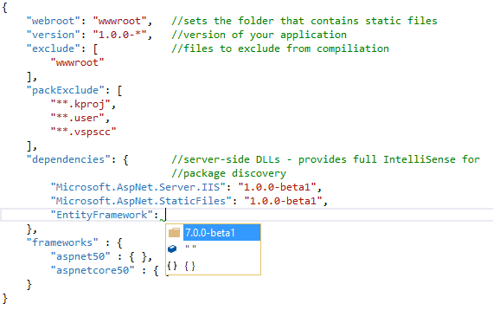
project.json
Replaces packages.config
General project configuration
Server-side dependencies
MSBuild

Slide 10
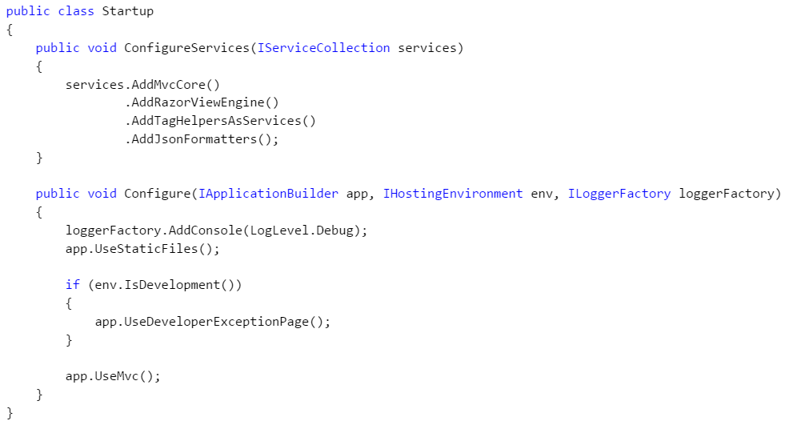
Startup.cs
Where services are registered and the application is configured

Slide 11
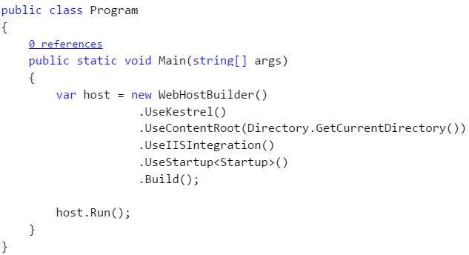
Program.cs
Unlike ASP.NET 4.6 apps, ASP.NET Core has a Main method!

Slide 12
Models
Where your ViewModels and DTOs live
Your domain objects should live elsewhere
But that’s another show

